Slide 1


The Ballerina CISO:
every door is a door - crafting your cybersecurity path
Carrie Nedrow, vCIO, vCISO, CISSP
Notes:
Good morning everyone. Thank you for
First — I have to say this.
Being here at WiCyS feels a little like walking into a room with 2,000 brilliant friends you haven't met yet.
[pause]
And if you're anything like me, you might also be thinking:
"Everyone here is smarter than I am."
[laughter beat]
Don't worry.
We all think that.
Let's just breath into the coolness that is Women in Cybersecurity for a second.
Now I want to start with a confession.
I did not start my career in cybersecurity.
[pause]
I started my career as a professional ballerina.
[pause]
Yes.
A ballerina.
[wait for reaction]
Which raises an important question:
How does someone go from pointe shoes to cybersecurity?
[pause]
The answer is the same way many of you got here.
Through unexpected doors.

Slide 2

Notes:
One of the biggest misconceptions about cybersecurity careers
is that there is one correct door.
[pause]
Point to the image.
Computer science degree.
Security certification.
Entry-level analyst job.
[pause]
Then:
But cybersecurity was actually built by people
who walked through unexpected doors.
Then list a few:
teachers
musicians
retail managers
military logistics planners
parents returning to the workforce
Pause.
Then:
Even ballerinas.
[laughter beat]
So let’s talk about that Ballerina thing. Many dancers' careers are a version of mine.

Slide 3
Built 3 Ballet Schools
Launched Pointe Shoe Co.
Alvin Ailey Faculty
WV Ballet School
Expert Authority
Creativity
Reliability
Know your Customer
Endurance
Commanding Presence
Mentorship
Repetition
Standards
Hierarchy/Place
RULES
Regional Copmany Tours
Corps de Ballet
Boston Ballet
Invention
Know Yourself
Collaboration
Attention to Detail
Quick Response
Tour w. Royal Ballet
Training in Toronto
Apprentice Paul Taylor
Cleveland Ballet
Tour w Modern Co.
The Juilliard School
Notes:
Phase 1 - Learning the business.
Phase 2 – Honing my craft
Phase 3 - Being the product
Phase 4 - Being the business

Slide 4
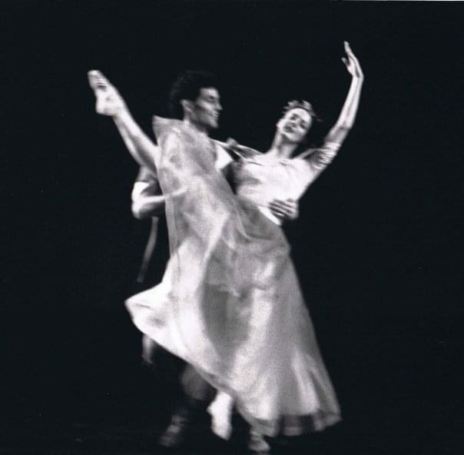
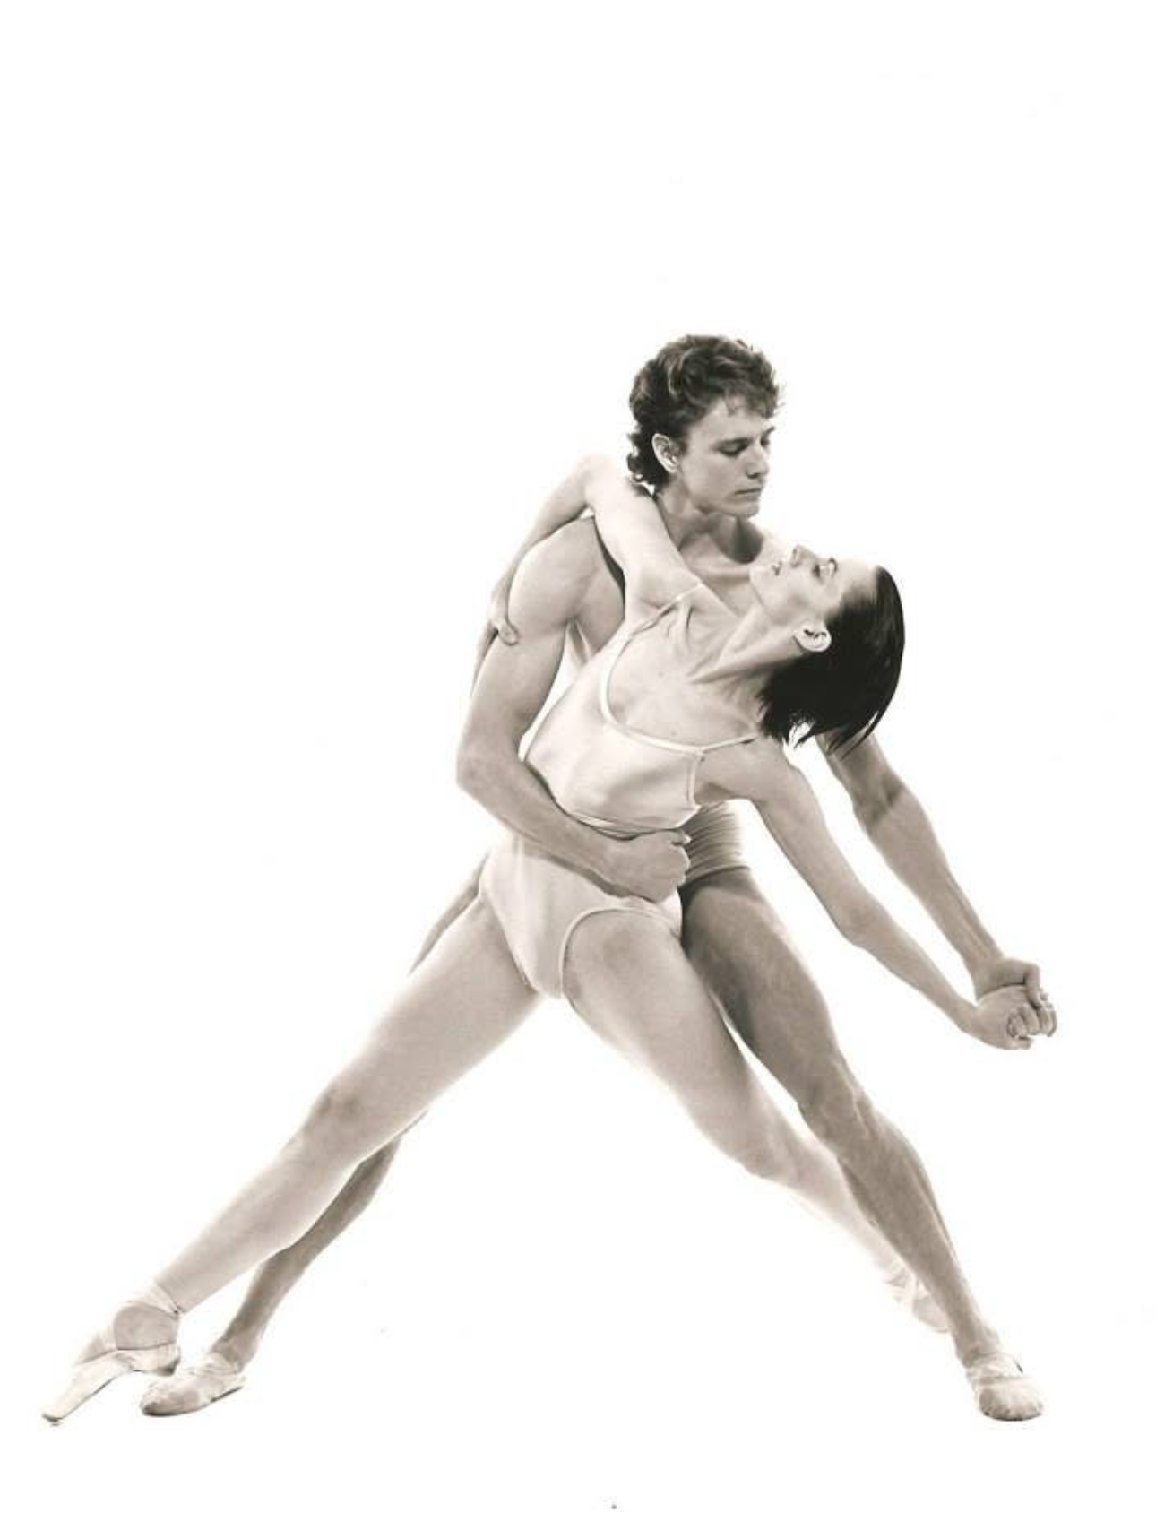
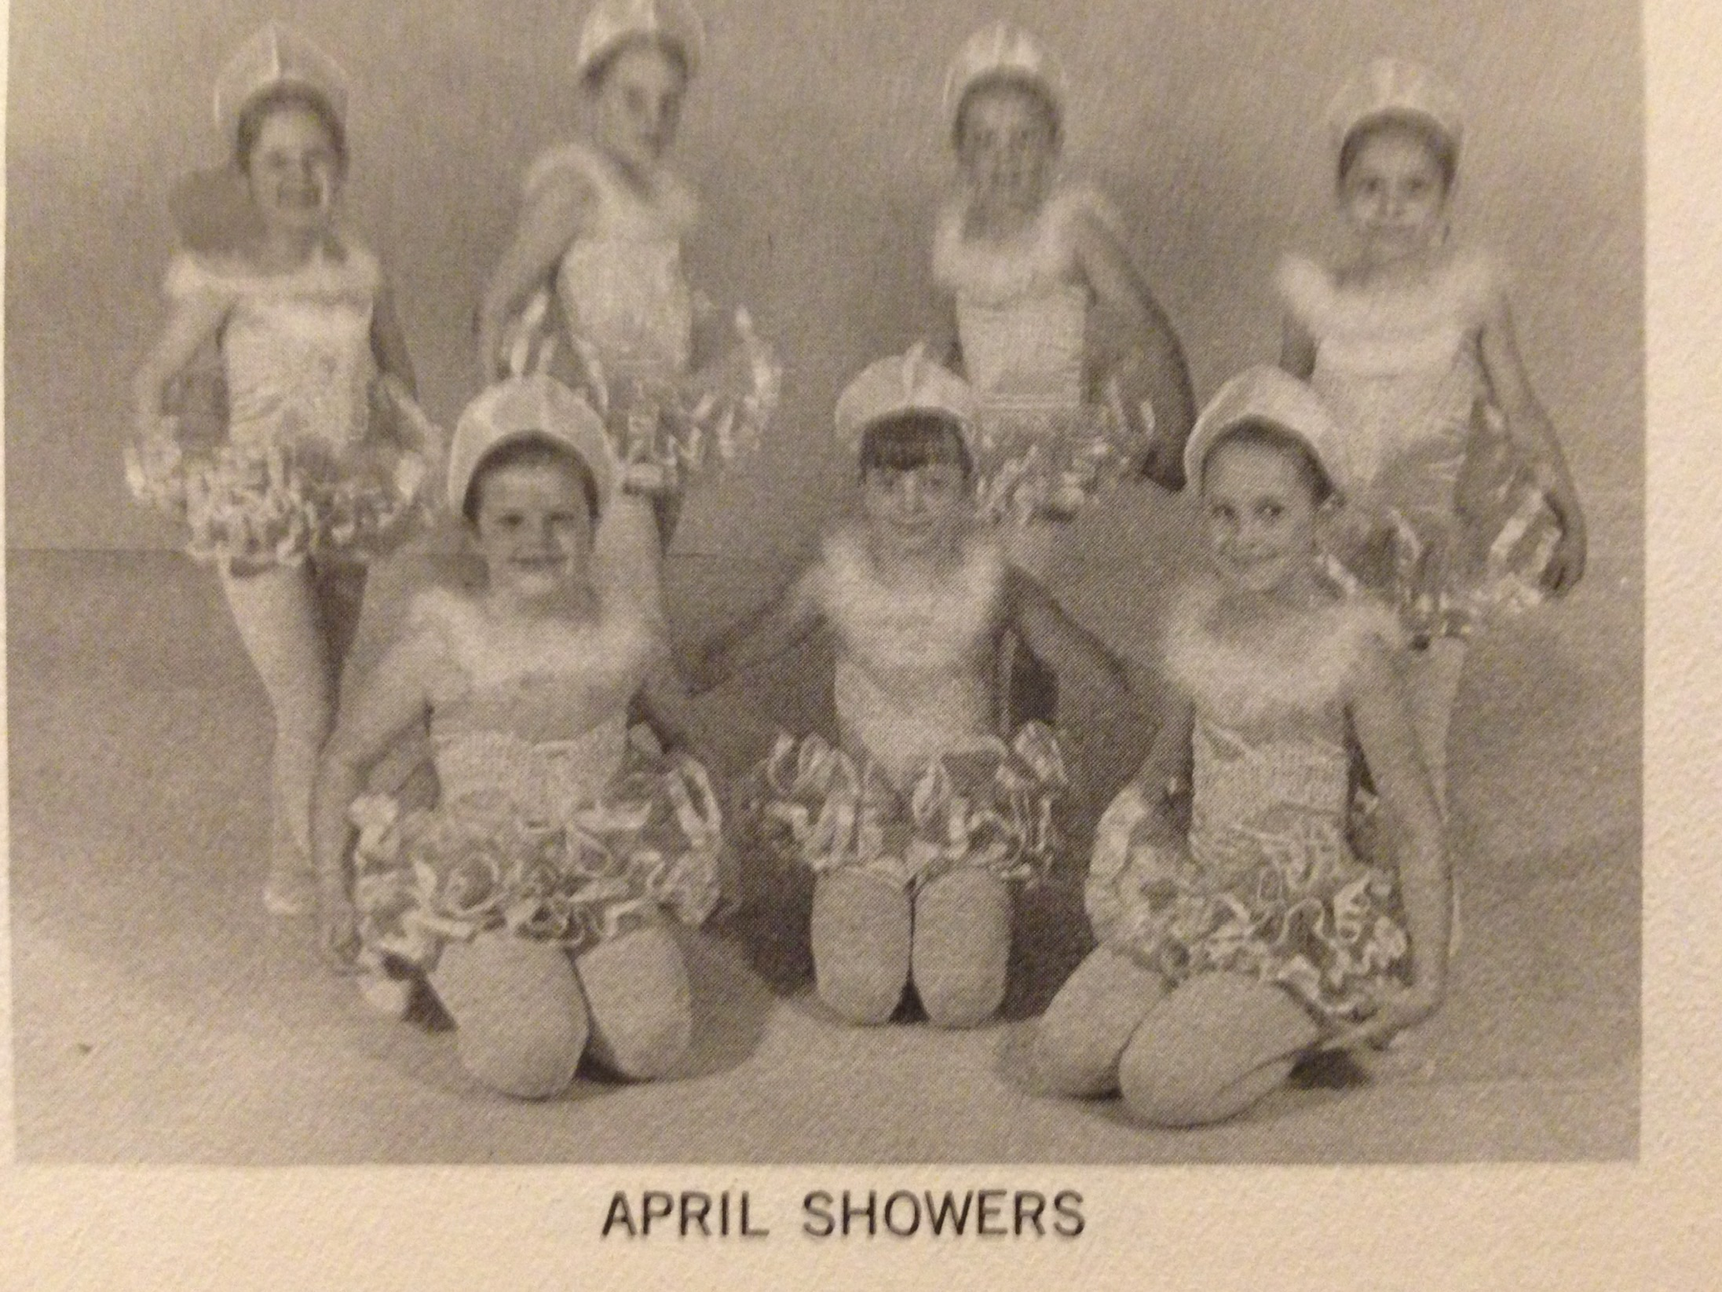
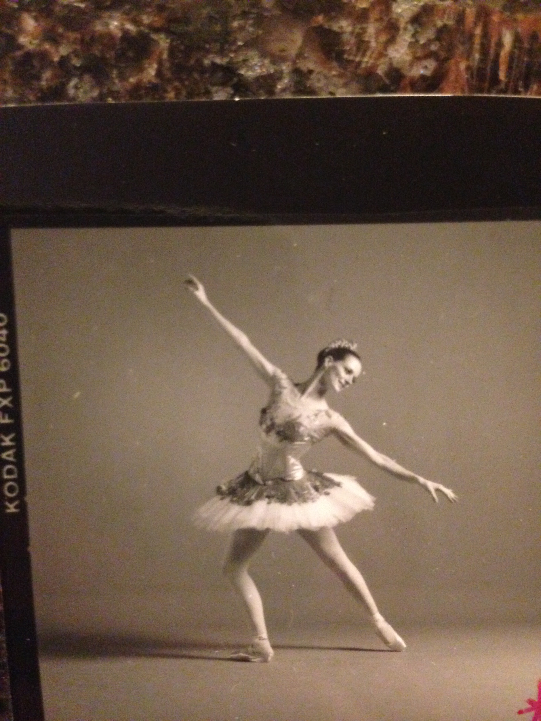
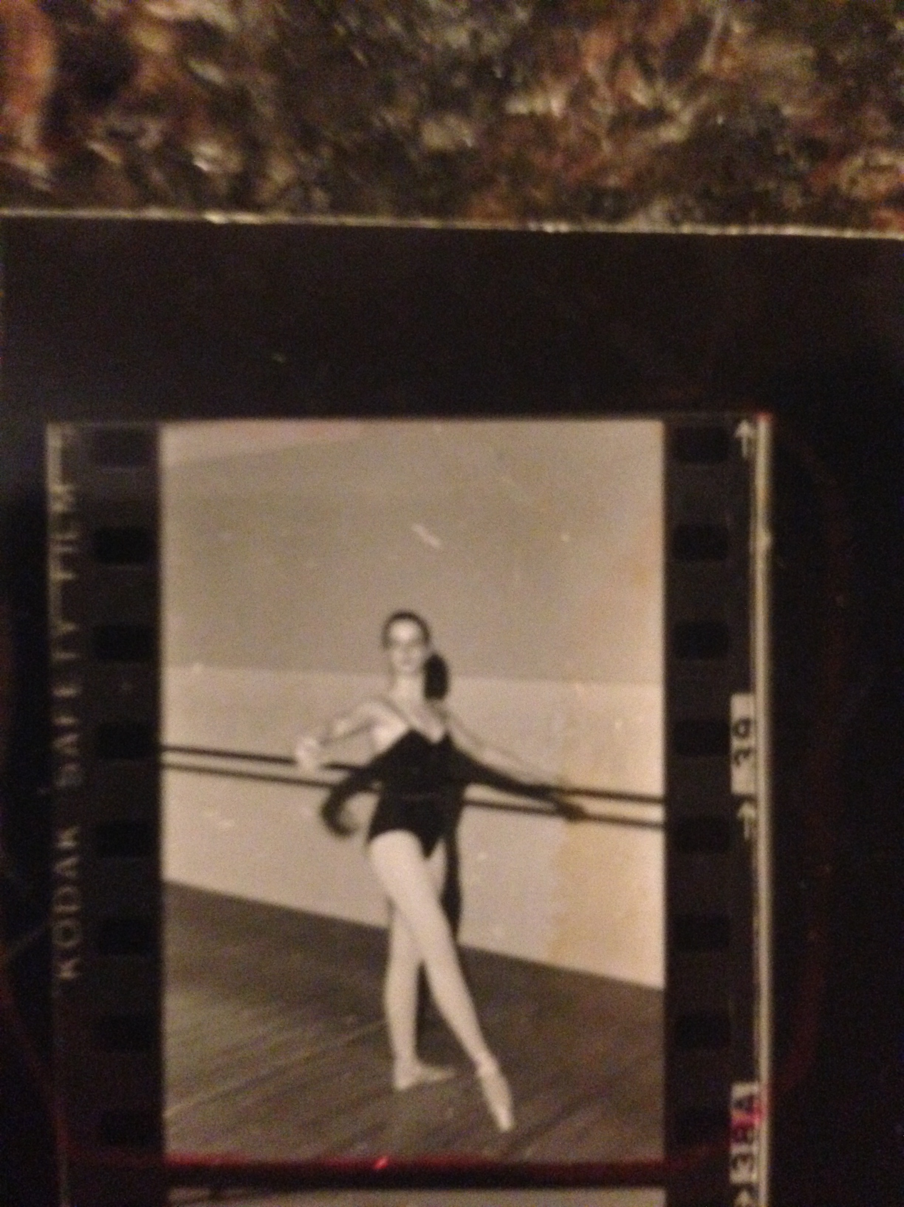
Ballet is one
GIANT SYSTEM
Technique + Music + Choreography +
Stage / Lights / Backstage
+
Accidents + Costumes + Injuries + Ego + Donors + Politics + Competition
Notes:
Dancers start as little dreamers. And then the work starts. It takes almost 2 decades to transition a finished product.
And that is because Ballet is one GIANT SYSTEM.
Let's decompose just one element of that: performing on stage
When you're a dancer performing on stage, you're managing a surprisingly complex system.
You must constantly evaluate:
technical accuracy
physical limits
spatial awareness
musical timing
emotional communication
unexpected problems
[pause]
Imagine you're mid-performance.
A dancer misses a cue.
A prop breaks.
Music changes tempo.
[pause]
You can't stop.
You can't restart.
You adapt in real time.
That moment is actually incident response.
[laugh]
The longer I work in cybersecurity, the more I realize something surprising.
The skills I learned in ballet were not irrelevant.
They were transferable systems skills.
We all have a Superpower.
Many people interested in cybersecurity think:
"I don't have the right background."
[pause]
But that’s the wrong question.
The real question is:
What is your superpower?
Pull out a pen, You have 30-seconds!
WHAT IS YOUR SUPERPOWER AND WHY DOES IT MAKE YOU A STRONGER SECURITY PROFESSIONAL?

Slide 5

30-Second Moment of Truth
You have exactly 30 seconds to
identify your strongest trait and articulate why
it makes you a stronger security professional.
I assemble the connections between many data points and quickly determine root cause, downstream impact, risks to the goals of the system, and how to engage stakeholders.
I can learn entire systems fast
Notes:
Every profession develops capabilities that security teams desperately need.
Examples:
Retail workers manage chaos and customer pressure.
Parents anticipate risk constantly.
Teachers detect patterns in behavior and learning.
[pause]
These are security skills.
Part of your storytelling is to be clear about how you arrived at this superpower.

Slide 6






How did you come by that?
Execution Accuracy
Capacity Management
Stakeholder Presence
Situational Awareness
Timing and Cadence
Incident Response
Position: It’s an innate talent that evolved over time.
Relate back:
Professional dancers are trained to assess risk, project confidence, and execute flawlessly under pressure.
Notes:
You must be SUPER CLEAR: I know my strength. I know how to demonstrate how my past informs that strength. You can talk about this all day. But you won’t. You’ll be crisp, to the point and move on.
The point is: it is a vocabulary test. Seriously. You know what you do. You know why it’s important. You just need the language to get you there.
Pro Tip: GEN AI is great at translating skills into business value statements.
It is what sets you apart and clarifies how your background and
5 — Superpower Moment
Slide: Your Superpower
Your background isn't the barrier.
Your background is the fuel.
[pause]
The key is learning how to translate it.
[move forward]
----

Slide 7



Transfer your learned skills in to industry value
Customer Service, Problem Solving, Prioritization, Theft Prevention, Financial Accountability, Quality Review, Organization, Inventory Management
Crisis Management
Incident response/ SOC
Ultimate Accountability, Teaching Mindset, Risk Prevention, Multi-Tasking, Budgeter
Risk Management
Threat Modelling for real life
Trust-worthy, timely, effective, collaborative, flexible, meticulous
GRC - Compliance
Controls & Evidence
Notes:
This is where you translate your non-traditional background into relatable required skills
Let’s test this idea.
If someone here works in retail, what skills do they bring?
[pause]
Customer pressure.
Inventory awareness.
Conflict management.
[pause]
That's operational security thinking.
If someone here is a teacher?
Pattern detection.
Communication.
Learning design.
If someone here comes from military logistics?
Risk planning.
Dependency management.
Operational sequencing.
[pause]
These are core cybersecurity competencies.
NEXT: You have exactly 30 seconds to identify
WHICH security roles best leverage your superpower.

Slide 8
30-Second Moment of Vision
You have exactly 30 seconds to identify
WHICH security roles best leverage your superpower.
Architect
System Engineer
IS Analyst/ SOC Analyst
Pen Tester/ E-Hacker
Forensics Analyst
GRC Analyst/ Auditor
Architect
System Engineer
IS Analyst/ SOC Analyst
Pen Tester/ E-Hacker
Forensics Analyst
GRC Analyst/ Auditor
I can learn entire systems fast
Notes:
Tell me some of the things you guys came up with.
Here’s what I came up with. I can learn entire systems fast.
The point is: it is not a 1:1 relationship. Basically, your strengths will naturally lead you to different types of work - when you dream the “I wanna be…” dream, look for how you will get there. ANY WAY THAT YOU CAN GET THERE.
In the WhoVa App, someone posed "Curious on how the presenter found their passion for Cyber - ballet seems like a far opposite career path."

Slide 9





Carrie’s Cyber Journey
mischief
Temp Paralegal
S&L Litigation
CRM/ERP Biz
Admin Asst & HD Slave
Y2K PMO
IDM
Unintentional Intentional
Financially motivated Sincerely Interested
Notes:
I did NOT take a straight path into IT or Cyber Security.
Mischief. Just imagine my brother and his best friend have access to a University computer system and I tag along.
Starving ballerina in New York City. I got a gig as a temp paralegel: Legal system, fraud, investigations, evidence... I had know idea that would be helpful down the road.
CRM/ERP - that pointe shoe company I helped launch introduced me to low-code tools, I started writing those for small businesses. Then Quickbooks came out.
Now I'm in Business School and I find out full time jobs pay for school – so I became a HD Tech and Admin Assist for a financial institution. I am doing everything – pulling cable, configuring networks, desktops, accounts, application management. I didn't think about it. I just needed the money.
And then I start to fall in love with companies. I had a sponsor thrust me into Y2K. I crushed it. I loved it.
Over time, I drove an identity management program at Intuit. which lead to JPMorgan. And my career keep moving forward from there.
AGAIN: The point is: it is not a 1:1 relationship. Basically, your strengths will naturally lead you to different types of work - when you dream the “I wanna be…” dream, look for how you will get there. ANY WAY THAT YOU CAN GET THERE.
Back to YOUR Superpower.
Once you identify your superpower, something powerful happens.
You can turn that capability into career momentum.
I want to remind EVERY SINGLE ONE OF YOU. If I can transform from a ballerina to whatever I am now, you can do EVERYTHING YOU WANT.

Slide 10
Your background is filled with genius
You are SMART
You are ADAPTABLE
You are RELENTLESS
Notes:
The fact that any one of you are here is proof that
you are SMART
You are ADAPTABLE
YOU ARE RELENTLESS
And that brings us to the simplest career engine I’ve ever seen.

Slide 11
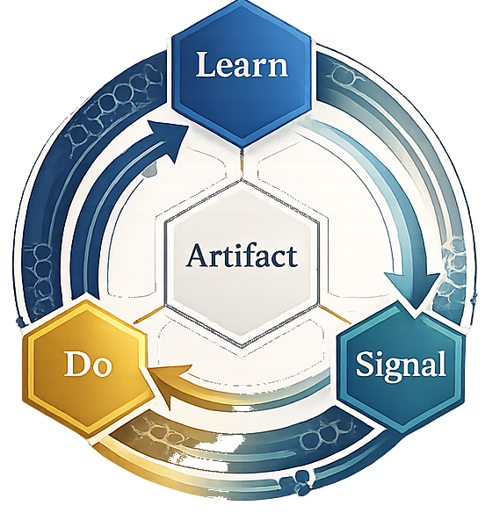
Getting from here to there
Learn
Signal
Research, Listen, Watch
Get feedback
Artifact
Show me
Do
Practice, Practice, Practice
Notes:
This model has three actions.
Learn.
Do.
Signal.
[pause]
First: Learn
Acquire just enough knowledge to understand the problem.
Not everything.
Just enough.
Second: Do
Create something real.
A checklist.
A small lab.
A control narrative.
Something tangible.
Third: Signal
Show the work.
Publish it.
Share it.
Ask for feedback.
7 — Momentum Layer
Slide: Artifact → Feedback → Opportunity
When you learn, do, and signal something interesting happens.
You produce an artifact.
Artifacts attract feedback.
Feedback creates opportunity.
[pause]
And then the wheel spins again.
Learn.
Do.
Signal.
Artifact.
Feedback.
Opportunity.
And then the Wheel Spins again.
This is how careers accelerate.

Slide 12
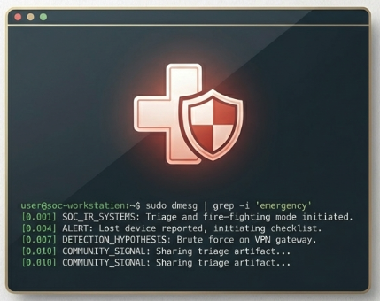
Example 1: CRISIS MANAGEMENT
(SOC & Incident Response)
The Job: Triage, fire-fighting
Learn: SIEM basics + four common log fields. Skim a MITR ATT&CK TTP
Do: Build a Tier-1 triage checklist for a lost laptop + one detection hypothesis
Signal: Share the checklist in community Discord; ask an active analyst for feedback.
Notes:
I picked simple examples. I want to move into an SOC and Incidnet Response
Learn the basics of SIEM and log fields.
Build a Tier 2 checklist – say a lost laptop or other asset
Push it out to a safe and friendly comminuty – Discord, OWASP, even Reddit.
"I created this checklist for a lost laptop, I'd love some feedback to make it right."

Slide 13
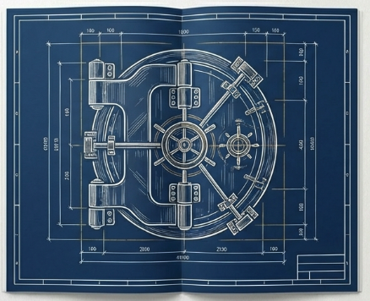
Example 2. GRC & Audit
The Job: Rules, risk, and proving the organization did what it promised
Learn: Read NIST 800-53 AC-2 & IA-2 (accounts and auth) + SOC 2 CC6.1 summaries (2 hours max)
Do: Draft a one-page control narrative for how your current team handles passwords, plus minimal evidence list
Signal: Post “How I’d document MFA for SOC 2” with the one-pager on LinkedIn. Ask a CRC pro to review and edit before posting.
Notes:
Pick a single area to learn.
Make a small one page control narrative.
Get feedback, share it with mostly friendlies –brown bag, lightening talk
These are just a few examples.
It doesn't matter where you are in your career.
Whether you are in middle school or reaching out to be a C-level you can use this model.
Know your Super Power
Know how you got there
Focus on a target
KEEP MOVING TOWARD THAT GOAL.

Slide 14
Make a 3-month accelerated plan
Month 3:
Role Alignment
Learn: Framework alignment (SOC2) or CI/CD security hooks
Do: 3-page control narrative bundle or demo pipeline
Signal: Send artifact directly to a hiring manager with a 4-sentance cover note
Month 2:
Depth
Learn: Cloud security basics
Do: Harden a small cloud lab; document before & after
SIgnal: 5-min lightening talk, brown bag
Month 1:
Foundations
Learn: IAM + logs 101
Do: SOC triage checklist v1
SIgnal: OWASP post + peer review
Notes:
Create a 3 month plan.
Someone asked in the app, basically, how to make signaling not noise, pandering to social media.
You need to be SUPER focused on WHAT you’re a communicating, and for what purpose.
Month 1 – get feedback
Month 2 – establish confidence
Month 3 – go for it
Here is the deal. As you create these artifacts, month after month after month, you are in the process of building relatinoships.
You will first find some peers.
Then you will find a mentor.
Eventually, you will find a sponsor. - someone who is willing to stick their neck on the line to push you to the front of an opportunity.
It is CRITICAL that you feed your peers, your mentor, and your sponsors of evidence that you are hungry, passionate, and capable.
They know your super power.
They know how it relates to your goals and passions
They know you are capaple
Because you know your superpower, how it relates, and you have EVIDENCE that you are capable.
Another person asked me about certifications and degrees vs...

Slide 15


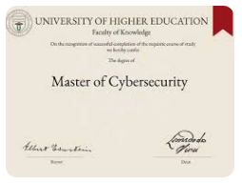




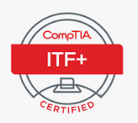
Time vs Money vs Impact
Incremental Change showing constant intentional progress is key.
Signalling Power
Effort
Notes:
In NO way am I saying, don't get a degree or that certification.
But those certs and degrees can take YEARS to begin to signal your competence and potential.
Signalling is THE important investment. This is an area where I fail. I have almost zero posts or evidence.
It takes tenacity.
Move

Slide 16

Time vs Money vs Impact
FOCUS is NOW
Continuous Professional Development
Get the Interview
Certs and Degrees are the long game
TARGET ZONE
$20 Cloud Lab + LinkedIn Write-up
GitHub PRs
1-Page Control Narratives
$X,XXX
Certification or degrees
Signalling Power
Memorizing Unused frameworks
Effort
Notes:
WHILE you’re chasing those certs and degrees, do the low effort high-signal low investment. IT WILL PAY OFF.

Slide 17
Parting Thoughts
Your Story is UNIQUE
You are SMART
You are ADAPTABLE
You are RELENTLESS
Cybersecurity needs people like you!

Slide 18

Discussion
Downloads at
www.enduring-solutions.com/WiCyS
Cybersecurity needs people like you!

Slide 19
Slides not used

Slide 20


Never have I ever…
Applied for security roles and never even gotten a screening call
Looked at jobs and thought, there is no way I’m qualified to do that
Been overlooked for new opportunities at my company
Known more than my manager
Tried to switch careers and found the barriers to entry overwhelming
Notes:
Are we drunk yet?
Put down your beverage, grab your writing implement, and pick up those papers that were on your chair. Look for the page that has a blank space at the top.
Switch gears. You have 30-seconds. Deep breath.
identify your strongest trait and articulate why
it makes you a stronger security professional.

Slide 21
Why spend this time together?
You are changing careers or roles
You are stuck in a “less-than” role
You have no idea where to start
You need a guideline
39% of Security roles are being filled by non-IT/Engineering folx.
It’s your job to play to your strengths and double down on your value.
Notes:
What we are NOT going to talk about:
Networking
Reaching across - making a lateral move, that’s a given
We are going to talk about positioning, evidence, and support, commonly referred to as the Learn-Do-Signal methodology.
We are going to focus on speed. We are going to focus on outcomes.

